Slide 1
OOP to Java programming language
Dr. Ahmad Altarawneh
Department of Data Science
Faculty of information technology, Mutah university

Slide 2
Agenda
Outline:
Brief history of Java
Overview of Java features
Setting up the Java Development Kit (JDK)
Your first Java program
Basic syntax and structure

Slide 3
OOP
Object-Oriented Programming or OOPs refers to languages that use objects in programming, they use objects as a primary source to implement what is to happen in the code.
Object-oriented programming aims to implement real-world entities and properties like inheritance.
The main aim of OOP is to bind together the data and the functions that operate on them in one entity.
so that no other part of the code can access this data except that entity or instances from that entity.

Slide 4
Classes
A class is a user-defined blueprint or prototype from which objects are created.
It represents the set of properties or methods that are common to all objects of one type.
Using classes, you can create multiple objects with the same behavior instead of writing their code multiple times.
This includes classes for objects occurring more than once in your code.
In general, class declarations can include these several components in order:

Slide 5
Cont.
Modifiers: A class can be public or have default access (Refer to this for details).
Class name: The class name should begin with the initial letter capitalized by convention.
Superclass (if any): The name of the class’s parent (superclass), if any, preceded by the keyword extends. A class can only extend (subclass) one parent.
Interfaces (if any): A comma-separated list of interfaces implemented by the class, if any, preceded by the keyword implements.
A class can implement more than one interface.
Body: The class body is surrounded by braces, { }.

Slide 6
Objects
An object is a basic unit of Object-Oriented Programming that represents real-life entities.
A typical Java program creates many objects, which as you know, interact by invoking methods.
The objects are what perform your code, they are the part of your code visible to the viewer/user.
An object mainly consists of:
State: It is represented by the attributes of an object. It also reflects the properties of an object.
Behavior: It is represented by the methods of an object. It also reflects the response of an object to other objects.
Identity: It is a unique name given to an object that enables it to interact with other objects.

Slide 7
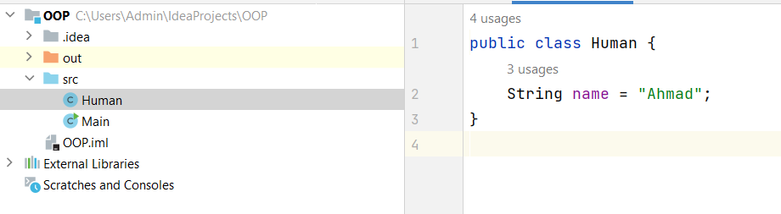
Example
Create a class called Human and has an attribute called name
The name here is an instance attribute which means, it will be unique for each instance created from this class, Human.

Slide 8
Cont.
Let us create two objects (humans) from this class.
By default, when the object is created, it takes the default value that initialized in the class
The attribute can be modified by reassigning a new value to the attribute
Use .(dot) to access the attributes and methods inside the object
public class Main { public static void main(String[] args) { Human h1 = new Human(); System.out.println(h1.name); Human h2 = new Human(); h2.name = "Maher"; System.out.println(h2.name); } }

Slide 9
Instance attribute vs class attribute
In the previous example, we saw that the name attribute is unique for each instance
We can make this attribute a class attribute by adding the keyword static
Now the attribute name belongs to the class.
Changing the attribute from h1 will automatically change it in h2
The name attribute can be accessed directly from the class i.e. Human.name = "New_name"
this attribute is shared among all instances
public class Human { static String name = "Ahmad"; }
public class Main { public static void main(String[] args) { Human h1 = new Human(); Human h2 = new Human(); h1.name = "Basel"; System.out.println(h1.name); System.out.println(h2.name); } }

Slide 10
Methods
Methods in java have several components
Access modifiers: Defines the access type of the method i.e. from where it can be accessed in your application.
In Java, there are 4 types of access specifiers:
public: Accessible in all classes in your application.
protected: Accessible within the package in which it is defined and in its subclass(es) (including subclasses declared outside the package).
private: Accessible only within the class in which it is defined.
default (package private): Accessible within the same class and package.

Slide 11
Cont.
The return type: The data type of the value returned by the method or void if it does not return a value.
Method Name: The rules for field names apply to method names as well, but the convention is a little different.
Parameter list: Comma-separated list of the input parameters that are defined, preceded by their data type, within the enclosed parentheses. If there are no parameters, you must use empty parentheses ().
Method body: It is the block of code, enclosed between braces, that you need to execute to perform your intended operations.

Slide 12
Constructors
In Java, a constructor is a special type of method that is called when an object of a class is created using the new keyword.
It has the same name as the class and does not have a return type, not even void.
The main purpose of a constructor is to initialize the newly created object.
Let us add a constructor to our previous example
public class Human { String name; public Human(String name){ this.name = name; } }
public static void main(String[] args) { Human h1 = new Human("Ahmad"); Human h2 = new Human("Maher"); System.out.println(h1.name); System.out.println(h2.name); }

Slide 13
this
This keyword you see in the previous code refers to the instance of the class
it is a reference to the object being called (current object)
h1.name => this refers to the name in object h1
h2.name => this refers to the name in object h2
in the constructor this.name = name means the name variable in the object being called is equal to the name passed to the constructor

Slide 14
Methods
Now this class has an attribute(s), the variable name, but it has no functionality
What humans can do
Functionality can be achieved by using methods, which can be implemented inside the class body
The general syntax of methods is as follows
<access_modifier> <return_type> <method_name>( list_of_parameters) { //body }

Slide 15
Cont.
Let us add some functionality for a human, like telling information about himself and eating
public class Human { String name; Human(String name){ this.name = name; } public void tellInfo(){ System.out.println("My name is " + this.name); } public void eat(){ System.out.println(this.name + " is eating now"); } }
public class Main { public static void main(String[] args) { Human h1 = new Human("Ahmad"); Human h2 = new Human("Maher"); h1.tellInfo(); h1.eat(); h2.tellInfo(); h2.eat(); } }
Call the method using the .Dot from the class instance

Slide 16
Static keyword
The methods we created so far are instance methods, which can be called from the class instance
There are some methods/variables that belong to the class rather than to an instance from the class
Assume we want to track how many objects are created from a class. Human class in our case
This attribute needs to be modified whenever we create an instance from the class
From the definition of this variable, it should be shared among all instances, and not unique for each instance

Slide 17
Cont.
This attribute objCounter can be called directly without creating an object
even if it is called from any instance created from this class it will hold the same value (because it is shared among the instances)
Think about the constant PI, should it be unique or shared in a class called math?
public class Human { String name; static int objConter; Human(String name){ this.name = name; objConter ++; }
public class Main { public static void main(String[] args) { Human h1 = new Human("Ahmad"); Human h2 = new Human("Maher"); System.out.println(Human.objConter); } }

Slide 18
Cont.
The static is not only for variables, but methods can also be static as well
Assume that we want a method to return the number of objects created from this class
This should be static method, shared among all instances and can be called directly from the class
public class Main { public static void main(String[] args) { Human h1 = new Human("Ahmad"); Human h2 = new Human("Maher"); Human h3 = new Human("Maher"); System.out.println(Human.howManyHumans()); System.out.println(h1.howManyHumans()); } }
public static int howManyHumans(){ return objConter; }
This method located inside the Human class

Slide 19
Access modifiers
In the previous example, Human class, attributes, and methods are defined as package private
And as we know public methods or attributes can be accessed from anywhere in the package, if they are left in their default access type
one can change the name directly in any location of the package
Imagine this attribute is an account balance!
access modifiers should be used wisely to support the functionality of the application with minimal risk

Slide 20
OOP with processing
before diving into more details about OOP programming, let us introduce ourselves to Processing package
Processing is a package that allows you to build animation-based applications
simulation, visualization, etc
Here we will use Processing to visualize objects and see how objects can interact with each other in a real environment
Better way to understand OOP

Slide 21
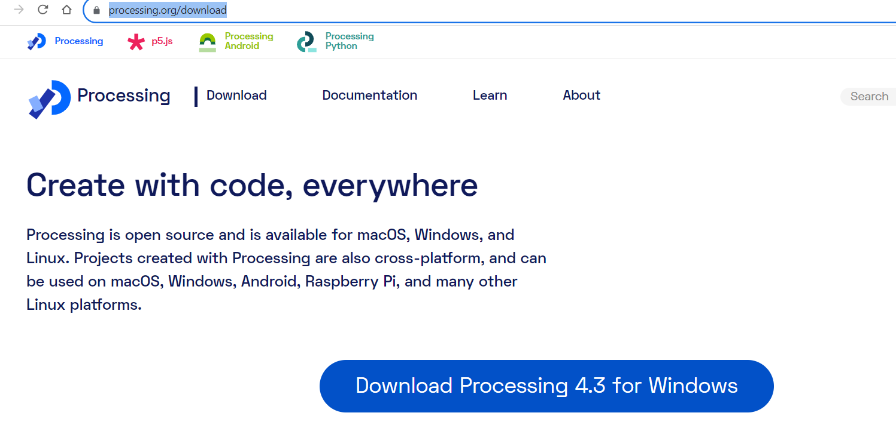
Installation
Go to the processing website and download it
https://processing.org/download

Slide 22

Cont.
unzip the file in any location u want

Slide 23
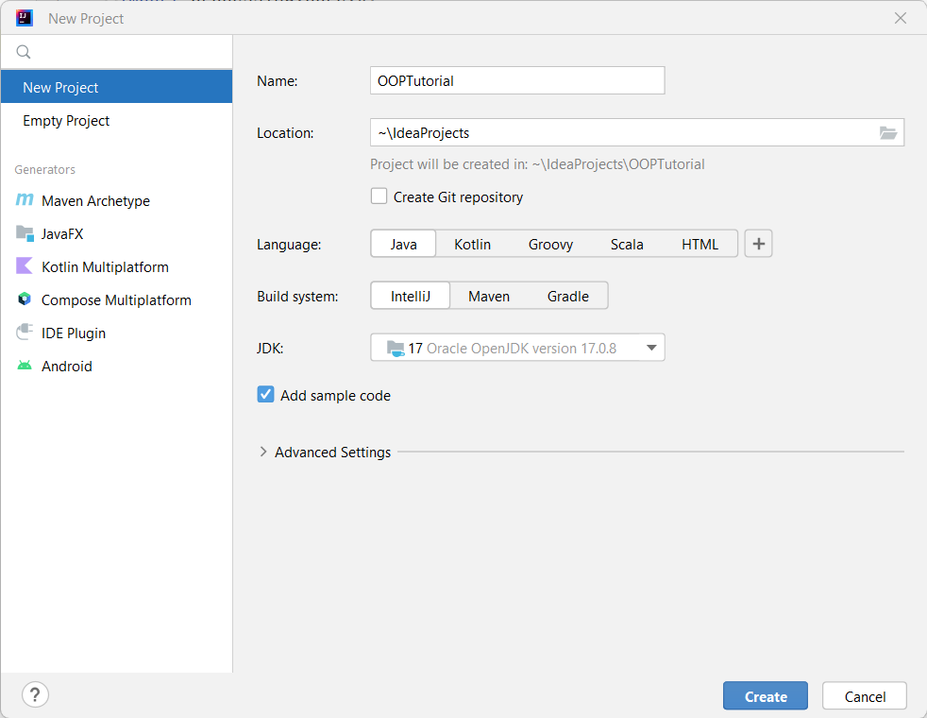
Integrate it into your project
Create the project

Slide 24
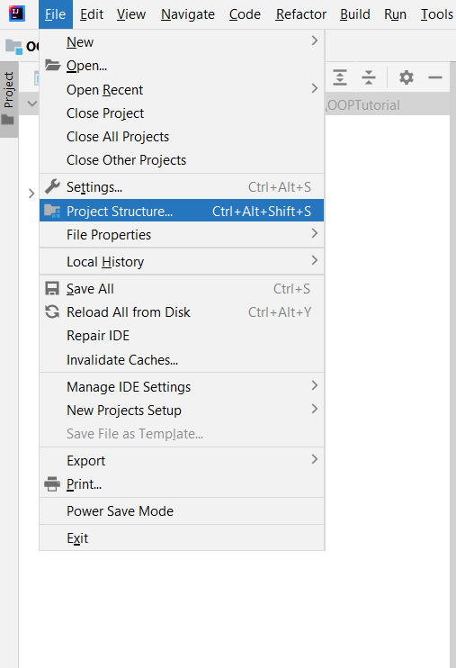
Cont.
Go to the file and then Project structure

Slide 25
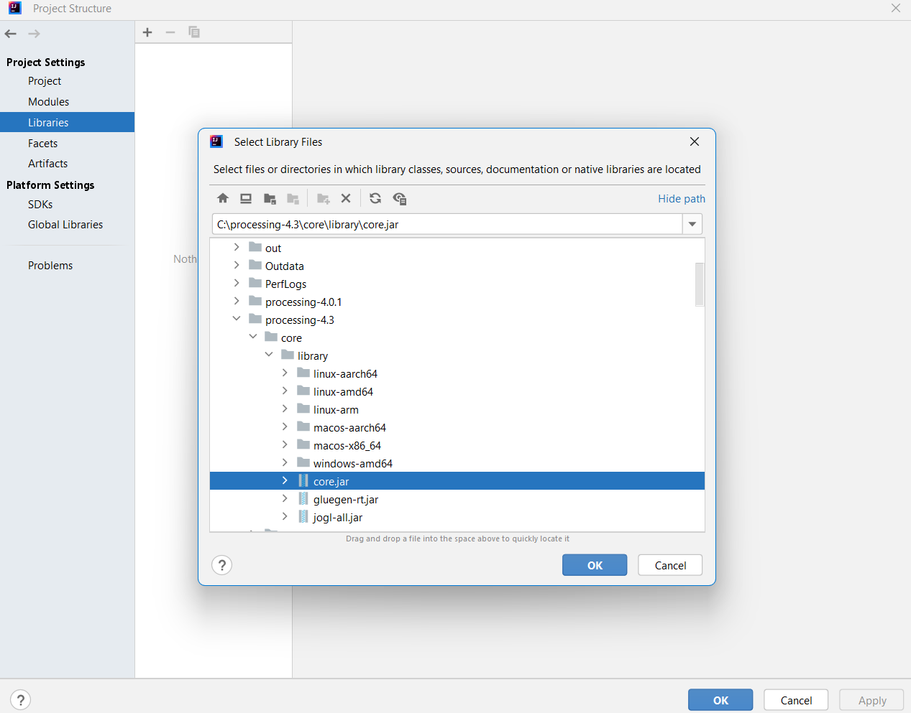
Cont.
Go to library and press the add button
navigate to core.jar

Slide 26
Your first code
import processing.core.*; public class Main extends PApplet { public static void main(String[] args) { PApplet.main("Main"); } public void settings() { size(800, 400); } public void setup() { } public void draw() { background(0,0,0); ellipse(100,100,5,5); } }

Slide 27
Understanding the methods
In processing there are 3 methods: setup, setting and draw
Setup is used for initializing the skitch when the application starts
it is executed once
Setting executed before the setup to control some sketch parameters such as framerate and the sketch size
draw continuously executed after the setup() function.
It's the core function responsible for rendering the sketch and is repeatedly called in a loop to update and redraw the contents of the canvas.

Slide 28
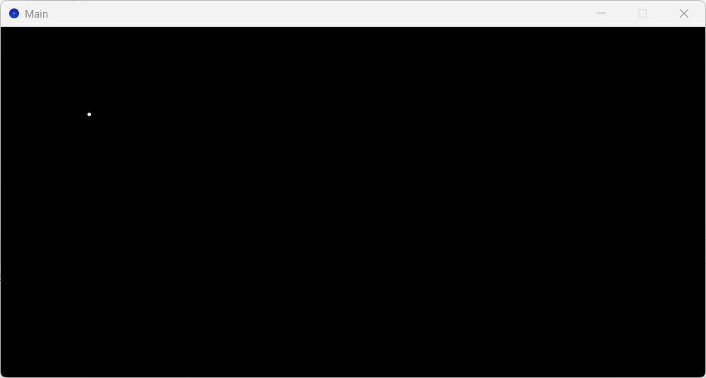
First sketch result
The previous code draws an ellipse of size 5 at location x=100 and y 100

Slide 29
Point class
Now we have just a point at a fixed location, let us add life to the sketch by creating a class called point and adding some attributes and actions
Attributes: what are the possible attributes of a point
let us start with one attribute, the location: x and y location of the point
Actions: let us start with one action, which is show
which draws the point at its location
import processing.core.*; public class Point { float xloc, yloc; Point(float x,float y){ this.xloc = x; this.yloc = y; } public void show(PApplet p){ p.ellipse(this.xloc,this.yloc,5,5); } }

Slide 30

Point object
import processing.core.*; public class Main extends PApplet { Point p; public static void main(String[] args) { PApplet.main("Main"); } public void settings() { int w = 800; int h = 800; size(w, h); } public void setup() { p = new Point(50,60); } public void draw() { background(0,0,0); p.show(this); } }
Now the point is created from the Point class

Slide 31
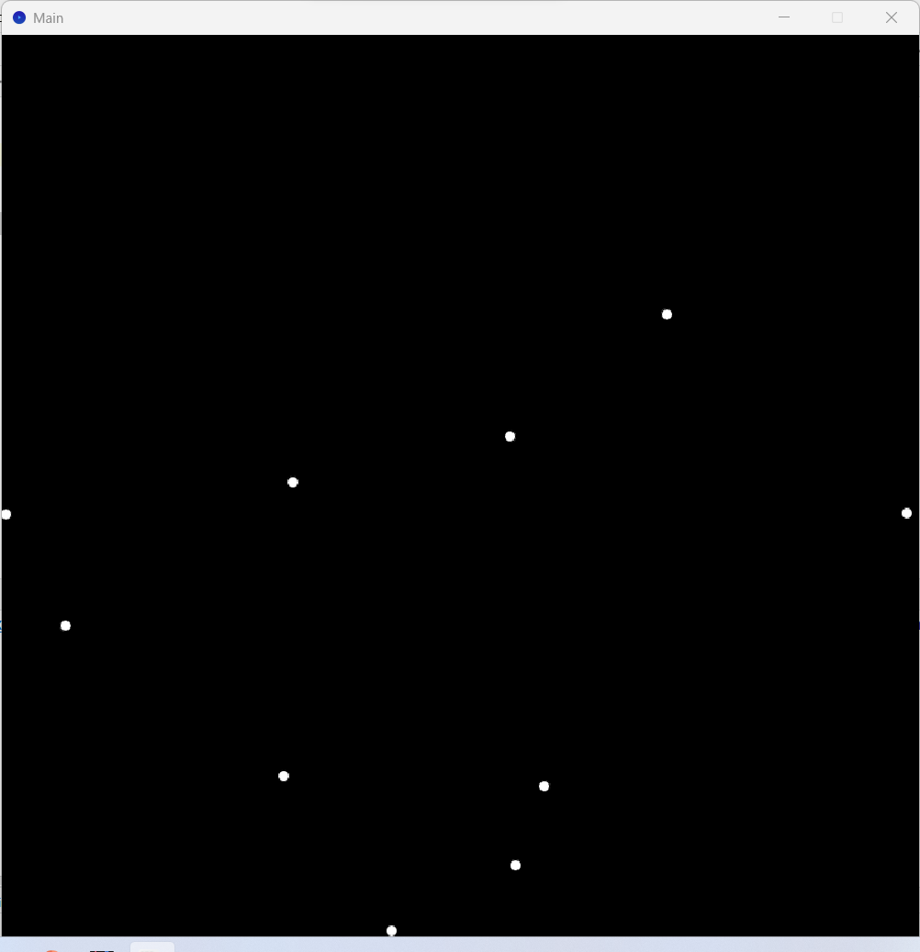
Multi objects
Let us create more objects (points)
for this we need an arraylist and two loops
one for creating the objects and one for displaying them
See the code next slide

Slide 32
import processing.core.*; import java.util.Random; import java.util.ArrayList; public class Main extends PApplet { Point p; int w,h; ArrayList<Point> points; public static void main(String[] args) { PApplet.main("Main"); } public void settings() { w = 800; h = 800; size(w, h); }
public void setup() { points = new ArrayList<>(); Random rand = new Random(); for (int i=0;i<10;i++){ float x = rand.nextFloat(w); float y = rand.nextFloat(h); p = new Point(x,y); points.add(p); } } public void draw() { background(0,0,0); for(Point p : points){ p.show(this); } } }

Slide 33
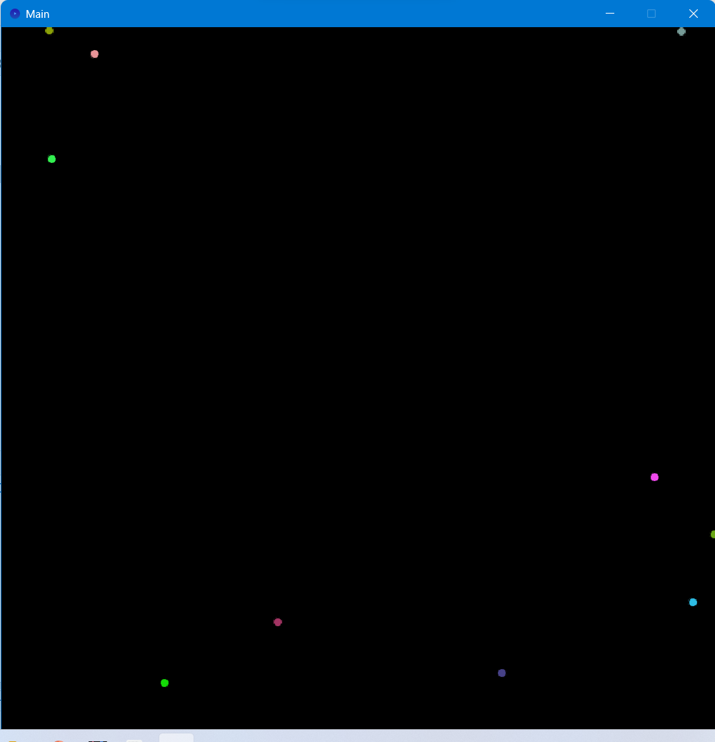
Make them colorful
import processing.core.*; import java.awt.*; public class Point { float xloc, yloc; Color c; Point(float x,float y,int[] color){ this.xloc = x; this.yloc = y; c = new Color(color[0],color[1],color[2]); } public void show(PApplet p){ p.fill(c.getRGB()); p.ellipse(this.xloc,this.yloc,10,10); } }

Slide 34
To be continued
We will come back to processing later after discussing more of OOP concepts

Slide 35

Encapsulation

Slide 36
Encapsulation
Encapsulation in object-oriented programming involves hiding the internal state (data/variables) of an object and providing access to it only through well-defined methods, thus controlling how the outside world interacts with the object's data
Key concepts related to encapsulation in Java:
Private Access Modifier: Encapsulation typically involves using the private access modifier to restrict direct access to the fields of a class.
By marking fields as private, they cannot be accessed or modified directly by code outside the class.
Getters and Setters: To provide controlled access to private fields, public methods (commonly known as getters and setters) are used to get and set the values of these private fields.
These methods enable controlled interaction with the internal state of the object.

Slide 37
Example
public class Human {
private int age;
public Human(int age) {
setAge(age); // Use the setter method for validation
}
public int getAge() {
return age;
}
public void setAge(int age) {
if (age > 0) { // Perform validation if needed
this.age = age;
} else {
System.out.println("Age should be a positive number.");
}
}
}

Slide 38
getters and setters
For every private variable we have a setter and getter, this is particularly useful when we need to validate the new data before we assign it to a private variable
Example,
Create a class called point which has two instance variables, x and y
Apply the encapsulation principle on these variables
See the next slide

Slide 39
public class Point { private int x,y; Point(int x, int y){ this.setX(x); this.setY(y); } void setX(int x){ if (x < 0){ System.out.println("The x value should be positive, the default x value is 0"); } else{ this.x = x; } } void setY(int y){ if (x < 0){ System.out.println("The y value should be positive, the default y value is 0"); } else{ this.y = y; } } int getX(){ return this.x; } int getY(){ return this.y; } }
public class Main { public static void main(String[] args) { Point p = new Point(-10,15); System.out.println(p.getX()); p.setX(10); System.out.println(p.getX()); } }

Slide 40

Inheritance

Slide 41
Inheritance
Inheritance is the mechanism in which a new class (subclass/child class) acquires properties and behaviors (methods and fields) from an existing class (superclass/parent class).
Supports code reusability
It promotes code reuse and establishes a hierarchy of classes
There are several types of inheritance:
Single Inheritance: Single inheritance refers to the scenario where a class extends only one parent class.
Multilevel Inheritance: Multilevel inheritance refers to a situation where a subclass inherits from a superclass, and another class extends this subclass, forming a chain of inheritance
Hierarchical Inheritance: Hierarchical inheritance involves multiple subclasses inheriting from a single superclass.
Multiple Inheritance (through Interfaces): Java does not support multiple inheritance directly. However, Java imitates multiple inheritance through interfaces

Slide 42
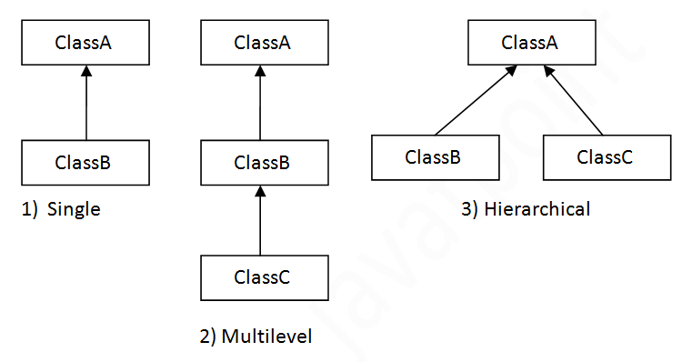
Cont.
The following diagram summarizes the main 3 types of inheritance in java

Slide 43
Example
class Vehicle { String brand; int year; public Vehicle(String brand, int year) { this.brand = brand; this.year = year; } public void displayInfo() { System.out.println("Brand: " + brand + ", Year: " + year); } }
super class
sub class
class Car extends Vehicle { int wheels; public Car(String brand, int year, int wheels) { super(brand, year); // calling superclass constructor this.wheels = wheels; } public void displayCarInfo() { System.out.println("Car Details:"); displayInfo(); // calling method from the superclass System.out.println("Number of wheels: " + wheels); } }
public class Main { public static void main(String[] args) { // Creating an instance of the Car class Car myCar = new Car("Toyota", 2022, 4); // Calling methods to display information myCar.displayCarInfo(); } }
This is an example of single inheritance

Slide 44
Method overriding
Method overriding in Java is a feature that allows a subclass to provide a specific implementation of a method already defined in its superclass.
This means that a subclass can define a method with the same name, return type, and parameters as a method in its superclass, thus providing its implementation of that method.
Important aspects related to overriding:
Method Signature: The method in the subclass must have the same signature (method name, parameters, and return type) as the method in the superclass.
@Override Annotation: It's a good practice (though not mandatory) to use @Override annotation when overriding a method.
It helps to ensure that the method is indeed intended to override a superclass method. The compiler can then catch errors if the method signature doesn’t match any method in the superclass.
Access Modifiers: The access level (visibility) of the overriding method in the subclass cannot be more restrictive than the method in the superclass

Slide 45
final, static, and private methods
final, static, and private methods cannot be overridden in Java.
final methods can't be overridden to prevent modification in the subclass.
static methods belong to the class and are not associated with instances.
private methods are not visible to the subclass.

Slide 46
method overloading
Method overloading in Java refers to the ability to have multiple methods in the same class with the same name but different parameters.
The parameters can differ in terms of their number, types, or order.
public class Calculator {
public int add(int a, int b) {
return a + b;
}
public int add(int a, int b, int c) {
return a + b + c;
}

Slide 47
Example
package Default;
import processing.core.PApplet;
public class Shape {
float x,y;
Shape(float x, float y){
this.x = x;
this.y = y;
}
void show(PApplet p){
p.fill(255);
p.ellipse(x,y,5,5);
}
void show(PApplet p, int side){
p.fill(255);
p.square(x,y,side);
}
void show(PApplet p, int height, int width){
p.fill(255);
p.rect(x,y,width,height);
}
}

Slide 48

Cont.
public void setup() {
s1= new Shape(50,50);
s2= new Shape(100,50);
s3= new Shape(150,50);
}
public void draw() {
background(0);
s1.show(this);
s2.show(this,20);
s3.show(this,20,50);
}

Slide 49

Polymorphism

Slide 50

Polymorphism
The previous two concepts lead us to talk about polymorphism
polymorphism consists of two words: poly, which means many, and morphism, which means shapes
Think of the Dota2 hero: morphling

Slide 51

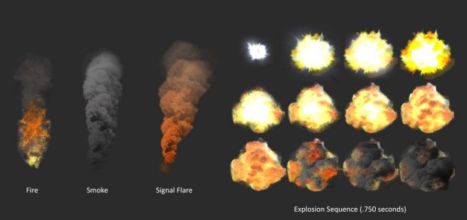
Cont.
Polymorphism can be achieved by using overriding or overloading
We saw how to employ this concept using overloading
let us use a processing example with overriding to employ polymorphism
The example is on creating a particle system
A particle system is a technique used in computer graphics, simulation, and game development to create and manage a large number of small, often identical, and simple objects called particles
to simulate real-life phenomena like fire, smoke, explosions, rain, snow, sparks, and more

Slide 52
Particle system
A particle system consists of a set of particles each of which has its own properties and behavior
So: we have the following
Particle system (class) because we might create more than one system
each one is an object created from the particle system class
Particle itself (class): we need many particles for a system, each of which has the following attributes:
Location
Velocity (speed)
Acceleration
And the following methods:
Display (show): how the particle shows itself.
Update (move): how a particle move.

Slide 53
Implementation (Particle class)
package Default;
import java.util.Random;
public class Particle {
int alpha;
PVector pos,speed,acc;
Random rand = new Random();
Particle(float x, float y){
this.pos = new PVector(x,y);
this.speed = new PVector(2* rand.nextFloat()-1, -4* rand.nextFloat()-1);
this.acc = new PVector(0,0);
this.alpha = 255;
}
We represent the location by a vector: each vector has an X location and a Y location. we can represent them separately as float x and float y. However, vectors give flexibility in the calculation. SAME for SPEED and Acceleration (all are vectors)

Slide 54
Cont. (Particle class)
We know from phiscs that the New location = Old location + Speed
And New speed = Old speed + Accelaration
void update(){
pos = pos.add(speed);
speed.add(acc);
this.alpha -= 5;
}
void display(PApplet p){
p.fill(255, this.alpha);
p.ellipse(pos.x, pos.y, 10, 10);
}

Slide 55
Particle system class
Now the particle system class the controls all the particles in it

Slide 56
public class ParticleSystem {
ArrayList<Particle> particles;
float x,y;
PApplet p = new PApplet();
ParticleSystem(float x, float y){
this.particles = new ArrayList<Particle>();
this.x = x;
this.y = y;
}
void update() {
particles.add(new Particle(this.x,this.y));
}

Slide 57
Particle system class
void display(PApplet p) {
for (int i = particles.size()-1; i >=0; i --) {
if (particles.get(i).alpha < 0) {
particles.remove(i);
}
else {
particles.get(i).update();
particles.get(i).display(p);
}
}
}

Slide 58
Main Class
public class Main extends PApplet{
public static void main(String [] args) {
PApplet.main("Default.Main");
}
ParticleSystem Psys;
public void settings() {
size (600,600);
}
public void setup() {
Psys = new ParticleSystem(300,300);
}
public void draw() {
background(0);
Psys.update();
Psys.display(this);
}
}

Slide 59

Abstraction

Slide 60
Abstraction
In Java, abstraction refers to hiding the implementation details of certain functionalities and showing only the essential features of an object.
It is one of the key principles of object-oriented programming (OOP) and helps manage complexity.
The developer can use this object without being concerned about how it is implemented as it does the required task
In java abstraction can be achieved using
abstract classes
interfaces

Slide 61
Abstract Class
An abstract class in Java is a class that cannot be instantiated on its own and may contain abstract methods (methods without a body) alongside concrete methods (methods with a body).
Abstract classes can have constructors, member variables, and both abstract and non-abstract methods.
They serve as a blueprint for other classes to extend and provide implementation for the abstract methods.
Regular classes cannot contain abstract methods
an abstract class can contain only concrete methods

Slide 62
Example
Let us make our shape class abstract
public abstract class Shape {
PVector pos, speed, accelaration;
Random rand = new Random();
PApplet App;
Shape(PApplet p, float x, float y){
this.pos = new PVector(x,y);
this.speed = new PVector(-2 + rand.nextFloat()*4,-2 + rand.nextFloat()*4 );
this.accelaration = new PVector(rand.nextFloat(),rand.nextFloat());
this.App = p;
}
public abstract void show();
public void move() {
this.pos.add(speed);
this.speed.add(accelaration);
if (pos.x < 0 | pos.x > App.width) {
speed.x *= -1;
accelaration.x *= -1;
}
if (pos.y < 0 | pos.y > App.height) {
speed.y *= -1;
accelaration.y *= -1;
}
}
}

Slide 63
Cont.
public class Circle extends Shape{
float radius;
Circle(PApplet p, float x, float y, float r){
super(p, x,y);
this.radius = r;
}
public void show() {
this.App.ellipse(this.pos.x, this.pos.y, this.radius, this.radius);
}
}
Since the Circle extends the Shape, it must provide implementations for all its abstract methods, if any.

Slide 64
Interface
An interface in Java is a collection of abstract methods that define a set of actions that implementing classes must support.
Unlike abstract classes, interfaces cannot contain method implementations or variables (except constants).
Classes implement interfaces by providing concrete implementations for all the methods declared in the interface.
Interfaces can provide up to 100% abstraction, in Java.
interfaces do not have a constructor and cannot be instantiated

Slide 65
Shape interface
package Default;
import processing.core.*;
public interface Shape {
void show();
void move();
}
As you see the interface provides a total abstraction of the Shape
The circle class must implement all the methods in the Shape interface
public class Circle implements Shape {
private PVector pos, speed, acceleration;
private Random rand = new Random();
private PApplet app;
...

Slide 66
call a specific implementation
Now you can call a specific implementation of the interface.
remember the calling of the ArrayList?
List<String> a = new ArrayList<>();
There are several data structures provides implementation for the list interface
List<String> arrayList = new ArrayList<>(); // ArrayList implementation
List<String> linkedList = new LinkedList<>(); // LinkedList implementation
List<String> vector = new Vector<>(); // Vector implementation
List<String> copyOnWriteArrayList = new CopyOnWriteArrayList<>();
So we can call the Circle implementation of the shape using:
Shape circle = new Circle()

Slide 67
Example
Assume that you want to implement some electrical devices and their electrical capabilities
// Interface for devices that can be powered on/off
interface PowerSwitchable {
void powerOn();
void powerOff();
}
// Interface for devices that can be charged
interface Chargeable {
void charge();
}
// Interface for devices that can connect to a network
interface NetworkConnectable {
void connectToNetwork();
}

Slide 68
Smartphone
Smartphone can be recharged and can be switched on and off, and can connect to network
We need to implement these properties through their interfaces
// Implement classes representing different electronic devices
class Smartphone implements PowerSwitchable, Chargeable, NetworkConnectable {
public void powerOn() {
System.out.println("Smartphone powered on");
}
public void powerOff() {
System.out.println("Smartphone powered off");
}
public void charge() {
System.out.println("Smartphone charging");
}
public void connectToNetwork() {
System.out.println("Smartphone connected to the network");
}
}

Slide 69
Laptop
Laptop has the same functionality as Smarphone
class Laptop implements PowerSwitchable, Chargeable, NetworkConnectable {
public void powerOn() {
System.out.println("Laptop powered on");
}
public void powerOff() {
System.out.println("Laptop powered off");
}
public void charge() {
System.out.println("Laptop charging");
}
public void connectToNetwork() {
System.out.println("Laptop connected to the network");
}
}

Slide 70
Fan
Fans cannot connect to the network and cannot be recharged
it can be switched on and off
In other scenarios we might have small fans that are chargeable.
class Fan implements PowerSwitchable {
public void powerOn() {
System.out.println("Fan powered on");
}
public void powerOff() {
System.out.println("Fan powered off");
}
}

Slide 71
OOP benefits
OOP provides several advantages to the developers, including:
Code Reusability: Large amount of your code can be reused in other places, without rewriting them repeatedly.
Simple Troubleshooting: Figuring out where the error is a simple thing in OOP compared to other programming paradigms.
Modularity: dividing the program into a set of modules is useful when debugging the code, or when we want to add new features
Code Security: through the encapsulation principle, we can prevent unauthorized access to the program's data and functionalities.
Scalability and Extendibility: OOP-based applications can be extended and scaled easily, by benefiting from the reusability and readability properties of OOP.

Slide 72
Thank you

